Slide 1
COURSE NAME – ADAPTIVE Software Engineering COURSE CODE – 22CS2119R
RISK MANAGEMENT IN SOFTWARE ENGINEERING PROJECTS

Slide 2
AIM OF THE SESSION
To familiarize students with the basic concept of Risk Management
INSTRUCTIONAL OBJECTIVES
This Session is designed to:
This Session is designed to:
1.Describe Risk Management
2. List out the various risks involved in software projects
3.Describe the steps to be taken to mitigate and manage the risks.
LEARNING OUTCOMES
At the end of this session, you should be able to:
1 Define Risk Management
2.Describe various risks associated with projects

Slide 3
Agenda
Risk and strategies
Software Risk Categorization
Seven Principles of Risk Management
Risk Management
Risk Projection
Assessing Risk Impact
Risk Refinement
Risk Mitigation, Monitoring, and Management (RMMM)

Slide 4
INTRODUCTION
A risk is a probable problem- it might happen, or it might not.There are main two characteristics of risk
Uncertainty- the risk may or may not happen that means there are no 100% risks. loss – If the risk occurs in reality , undesirable result or losses will occur
Reactive risk strategies:"Don't worry, I'll think of something“ Nothing is done about risks until something goes wrong . The team then flies into action in an attempt to correct the problem rapidly
Proactive risk strategies : Primary objective is to avoid risk and to have a contingency plan in place to handle unavoidable risks in a controlled and effective manner

Slide 5
Software Risk Categorization
Categories of risks: There are three following categories of risks:
Project risks: Which effects the project schedule or resources e.g. loss of experienced project designer.
Product risks: Which effect the quality of the project that is being developed e.g. the failure of a purchased component to perform as expected.
Business Risks: Which effect the organization developing or procuring the software or e.g. a competitor introducing the a new product is a business risk.

Slide 6
Seven Principles of Risk Management
The Software Engineering Institute (SEI)(www.sei.cmu.edu) identifies seven principles that “provide a framework to accomplish effective risk management.”
They are:
Maintain a global perspective: view software risks within the context of a system in which it is a component and the business problem that it is intended to solve
Take a forward-looking view: think about the risks that may arise in the future (Example: due to changes in the software)
establish contingency plans so that future events manageable.

Slide 7
Seven Principles of Risk Management
Encourage open communication:if someone states a potential risk, don’t discount it. If a risk is proposed in an informal manner, consider it. Encourage all stakeholders and users to suggest risks at any time.
Integrate:a consideration of risk must be integrated into the software process.
Emphasize a continuous process: the team must be vigilant throughout the software process, modifying identified risks as more information is known and adding new ones as better insight is achieved.

Slide 8
Seven Principles of Risk Management
Develop a shared product vision:if all stakeholders share the same vision of the software, it is likely that better risk identification and assessment will occur.
Encourage teamwork:the talents, skills, and knowledge of all stakeholders should be pooled when risk management activities are conducted

Slide 9
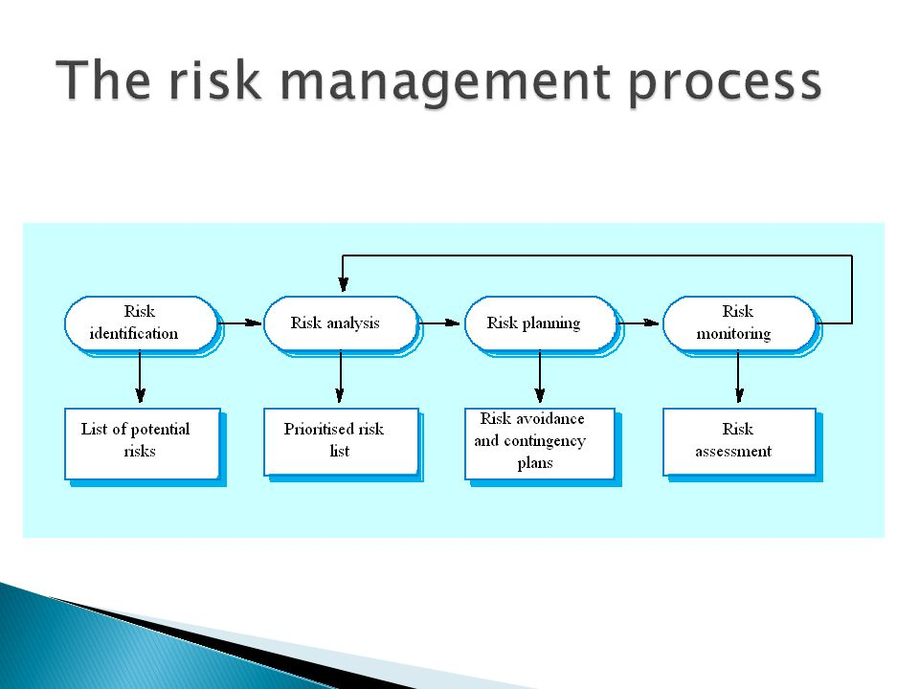

Slide 10
Risk management
Risk management is a sequence of steps that help a software team to understand , analyze and manage uncertainty.
It perform certain activities
Risk management consists of
i)Risk Identification
ii)Risk Projection
iii)Risk Refinement
iv)RMMM

Slide 11
Risk Identification:
Risk identification is the first stage of risk management and it concerned with identifying possible risks to the project.
May be a team activities or based on the individual project manager’s experience.
A checklist of different types of risks may be used to identify risks in a project.
Technology risks
People risks
Organizational risks
Tools risks
Requirements risks
Estimation risks

Slide 12
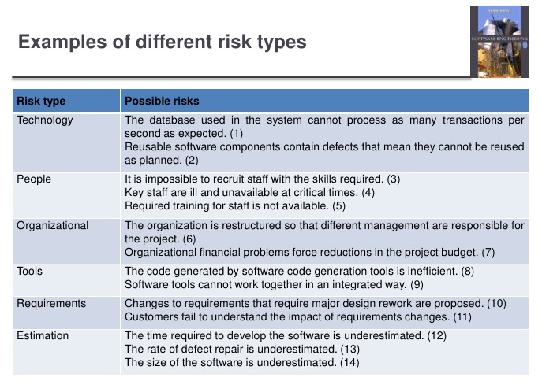

Slide 13
Risk Analysis and Prioritization
It is a process that consists of the following steps:
Identifying the problems causing risk in projects
Identifying the probability of occurrence of problem
Identifying the impact of problem
Assigning values to step 2 and step 3 in the range of 1 to 10
Calculate the risk exposure factor which is the product of values of step 2 and step 3 Prepare a table consisting of all the values and order risk on the basis of risk exposure factor

Slide 14
RISK PROJECTION
Risk projection, also called risk estimation, attempts to rate each risk in two ways—
(1) the likelihood or probability that the risk is real and
(2) the consequences of the
problems associated with the risk, should it occur. You work along with other managers
and technical staff to perform four risk projection steps:
1. Establish a scale that reflects the perceived likelihood of a risk.
2. Delineate the consequences of the risk.
3. Estimate the impact of the risk on the project and the product.
4. Assess the overall accuracy of the risk projection so that there will be no misunderstandings.

Slide 15
Contents of a Risk Table
A risk table provides a project manager with a simple technique for riskprojection
It consists of five columns –
Risk Summary – short description of the risk
Risk Category – one of seven risk categories
Probability – estimation of risk occurrence based on group input – Impact –
(1) catastrophic
(2) critical
(3) marginal
(4) negligible
RMMM – Pointer to a paragraph in the Risk Mitigation, Monitoring, and Management Plan
Risk | riskcateogry | probability | impact | RMMM

Slide 16
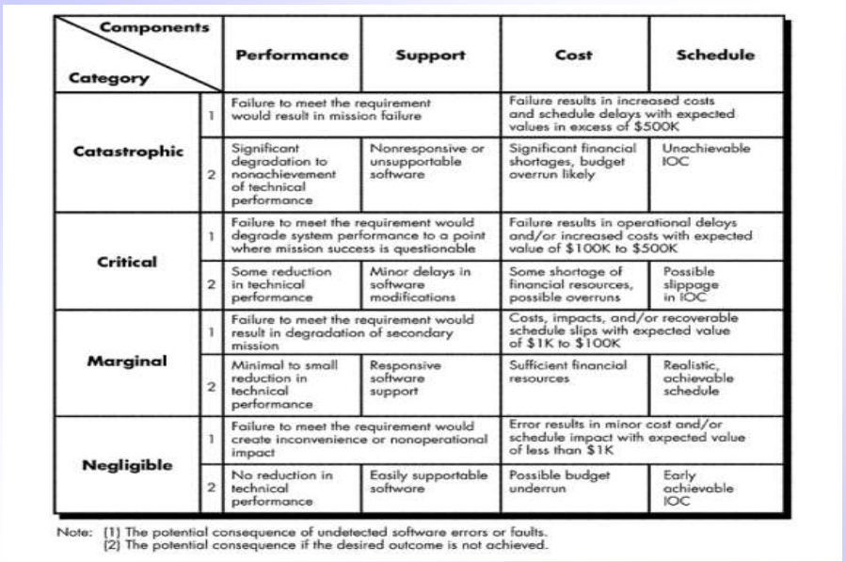

Slide 17
Risk projection steps
Risk projection (or estimation) attempts to rate each risk in two ways
The probability that the risk is real –
The consequence of the problems associated with the risk, should it occur
Risk Projection/Estimation Steps
Establish a scale that reflects the perceived likelihood of a risk (e.g., 1-low, 10-high)
1) Delineate the consequences of the risk
2) Estimate the impact of the risk on the project and product
3) Note the overall accuracy of the risk projection so that there will be no misunderstandings

Slide 18
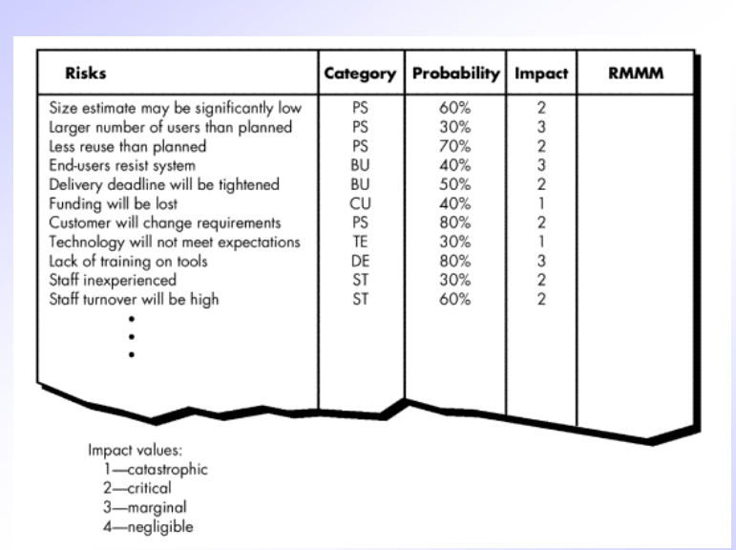
Developing a Risk Table
List all risks in the first column (by way of the help of the risk item checklists)
Mark the category of each risk
Estimate the probability of each risk occurring
Assess the impact of each risk based on an averaging of the four risk components to determine an overall impact value
Sort the rows by probability and impact in descending order
Draw a horizontal cutoff line in the table that indicates the risks that will be given further attention

Slide 19
Assessing Risk Impact
The overall risk exposure formula is RE = P x C
– P = the probability of occurrence for a risk
– C = the cost to the project should the risk actually occur
Example
P = 80% probability that 18 of 60 software
components will have to be developed
C = Total cost of developing 18 components is
$25,000
RE = .80 x $25,000 = $20,000

Slide 20
Risk Refinement
During early stages of project planning, a risk may be stated quite generally. As time passes and more is learned about the project and the risk, it may be possible to refinethe risk into a set of more detailed risks, each somewhat easier to mitigate, monitor, and manage.
One way to do this is to represent the risk in condition-transition-consequence
the risk is stated in the following form:
Given that <condition> then there is concern that (possibly) <consequence>
Using the CTC format you could write:
Given that all reusable software components must conform to specific design standards and that some do not conform, then there is concern that (possibly) only 70 percent of the planned reusable modules may actually be integrated into the as-built system, resulting in the need to custom engineer the remaining 30 percent of components.

Slide 21
Risk Refinement
This general condition can be refined in the following manner:
Subcondition 1. Certain reusable components were developed by a third party with no knowledge of internal design standards.
Subcondition 2. The design standard for component interfaces has not been solidified and may not conform to certain existing reusable components.
Subcondition 3. Certain reusable components have been implemented in a language that is not supported on the target environment

Slide 22
Risk Monitoring
Risk monitoring involves regularly assessing the each identified risks to decide whether or not that risk is becoming more or less probable, and whether the effects of the risks have changed.
Other factors (Indicators) need to have a look that gives the clue about the risks probability and its effect, and these factors (Indicators) are dependent with the types of the risks.
Each key risk should be discussed at management progress meetings.

Slide 23
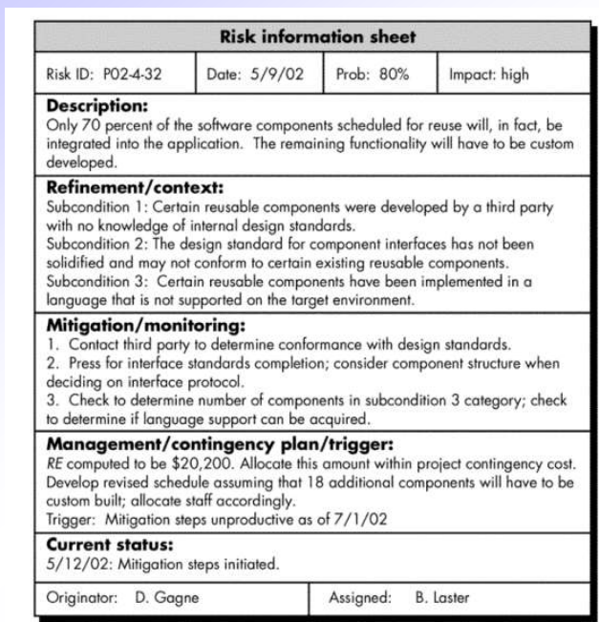
The RMM Plan

Slide 24
TERMINAL QUESTIONS
Define Risk management
Explain Assessing risk impact
Explain risk management and monitoring
Explain RMMM plan in detail
Elaborate on risk projection steps.

Slide 25
REFERENCES FOR FURTHER LEARNING OF THE SESSION
Reference Books:
TEXT BOOKS:
Roger S.Pressman, “Software Engineering – A Practitioner’s Approach” 7th Edition, Mc Graw Hill,(2014).
Ian Sommerville, “Software Engineering”, Tenth Edition, Pearson Education, (2015).
Reference Book
Agile and Iterative Development: A Manager's Guide, Craig Larman, Addison-Wesley
WEB REFERNCES/MOOCS:
https://www.digite.com/kanban/what-is-kanban/
http://www.scaledagileframework.com
https://www.guru99.com/test-driven-development.html
https://junit.org/junit5/

Slide 26

THANK YOU
Team – Adaptive Software Engineering

